Slide 1
Semester Project

Slide 2
Agenda
Team member roles and responsibilities
Use cases
High-level architecture
Database
Submission program
File acceptor web service
Collection process
Web user interface

Slide 3
Team member roles and responsibilities
Point-of-Contact: Jake Feldmann
Database Arch. : Wade Mayham
Web Architect: Zhaolong Zhong
Web UI Lead: Zhaolong Zhong
Web UI B/U: Amit Rama Akula
Web Serv. Lead: Kyle Eggemeyer
Web Serv. B/U: Jake Feldmann
Submission Prg. Lead: Amit Rama Akula
Submission Prg. B/U: Wade Mayham
Collection Prc. Lead: Jordyn Archie
Collection Prc. B/U: Kyle Eggemeyer

Slide 4
Use cases

Slide 5
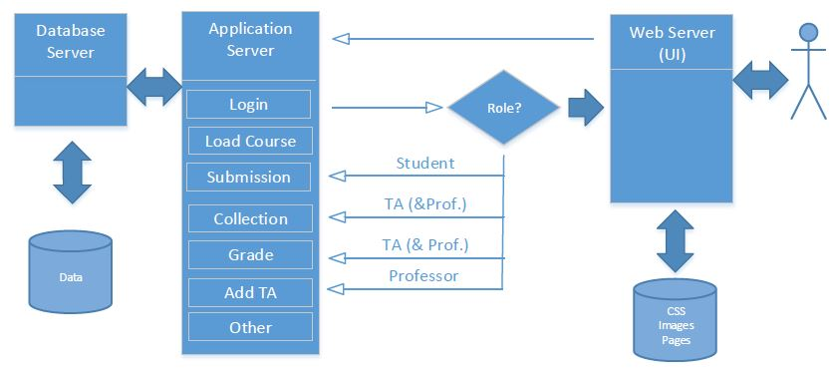
High-level architecture

Slide 6
High-level architecture
Check user exists or no and the user role
Redirect to specific page according to the role -student page -TA page -instructor page
Load course info in homepage(may be three) including course names(assume there are many courses for each student, but only one course for TA, many course for professor.)
Click course name to redirect to specific course
-Student page: load assignment info, submission
-TA page: load assignment info, create assignments, collection assignment, grade
-Instructor page: do the same stuff to TA, but can add TA

Slide 7
Database

Slide 8
Submission program

Slide 9
File acceptor web service

Slide 10
Collection process

Slide 11
Web user interface

